Slide 1
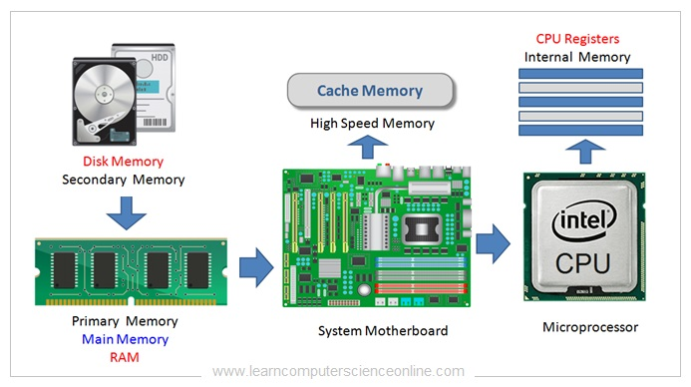
Applications/Example

Slide 2
Overview
Memory Hierarchy
Main Memory
Auxiliary Memory
Associative Memory
Cache Memory
Virtual Memory
Parallel Computing
Pipelining
Multiprocessors
Interconnection Structures

Slide 3
Memory Hierarchy
Memory Hierarchy is to obtain the highest possible access speed.
While minimizing the total cost of the memory system.
Magnetic
tapes
I/O
Main
processor
memory
Magnetic
disks
CPU
Cache
memory
Register
Cache
Main Memory
Magnetic Disk
Magnetic Tape

Slide 4
Main Memory
RAM and ROM Chips
Typical RAM chip
Chip select 1
CS1
Chip select 2
CS2
128 x 8
Read
RD
RAM
8-bit data bus
Write
WR
7-bit address
AD 7
CS1 CS2 RD WR
Memory function
State of data bus
0 0 x x
Inhibit
High-impedence
0 1 x x
Inhibit
High-impedence
1 0 0 0
Inhibit
High-impedence
1 0 0 1
Write
Input data to RAM
1 0 1 x
Read
Output data from RAM
1 1 x x
Inhibit
High-impedence
Typical ROM chip
Chip select 1
CS1
Chip select 2
CS2
512 x 8
8-bit data bus
ROM
9-bit address
AD 9

Slide 5
Memory Address Map
Address space assignment to each memory chip
Example: 512 bytes RAM and 512 bytes ROM
Hexa
address
Address bus
Component
10 9 8 7 6 5 4 3 2 1
RAM 1
RAM 2
RAM 3
RAM 4
ROM
0000 - 007F
0080 - 00FF
0100 - 017F
0180 - 01FF
0200 - 03FF
0 0 0 x x x x x x x
0 0 1 x x x x x x x
0 1 0 x x x x x x x
0 1 1 x x x x x x x
1 x x x x x x x x x
Memory Connection to CPU
RAM and ROM chips are connected to a CPU through the data and address buses
The low-order lines in the address bus select the byte within the chips
And other lines in the address bus select a particular chip through its chip select inputs

Slide 6
Connection of Memory to CPU
Address bus
CPU
16-11
10
9
8
7-1
RD
WR
Data bus
Decoder
3
2
1
0
CS1
CS2
128 x 8
Data
RD
RAM 1
WR
AD7
CS1
CS2
128 x 8
Data
RD
RAM 2
WR
AD7
CS1
CS2
128 x 8
Data
RD
RAM 3
WR
AD7
CS1
CS2
128 x 8
RD
RAM 4
Data
WR
AD7
CS1
1- 7
CS2
512 x 8
8
ROM
Data
9
AD9

Slide 7
Auxiliary memory, also known as secondary storage or external memory, is non-volatile, high-capacity, low-cost storage used for long-term data retention, which cannot be directly accessed by the CPU. It retains data when power is off, providing massive storage (terabytes) for files and programs.

Slide 8
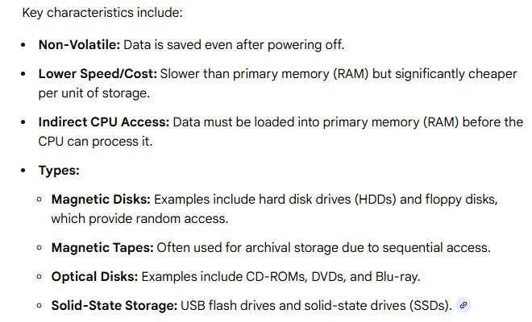

Slide 9

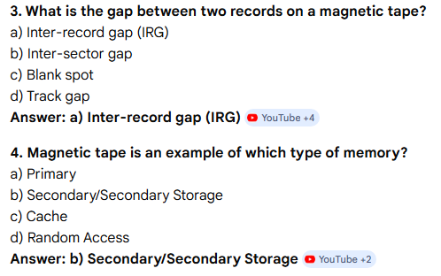

Slide 10
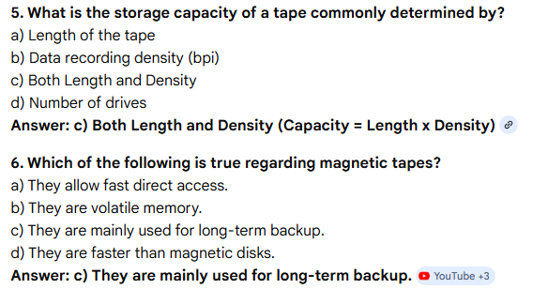

Slide 11
Auxiliary Memory
Information Organization on Magnetic Tapes
file i
block 1 block 2
block 3
EOF
R1
R2 R3 R4
R5
block 3
IRG
R6
EOF
R1
R5 R4
R3 R2
block 1
block 2
Organization of Disk Hardware
Moving Head Disk Fixed Head Disk
Track

Slide 12
Disk hardware organization refers to the physical structure and components of a hard disk drive (HDD), which is a non-volatile storage device that stores data permanently, unlike volatile RAM. It is organized into concentric rings, sectors, and cylinders to manage data access.

Slide 13
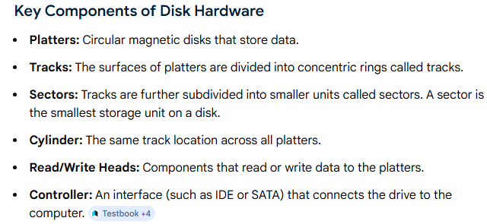

Slide 14
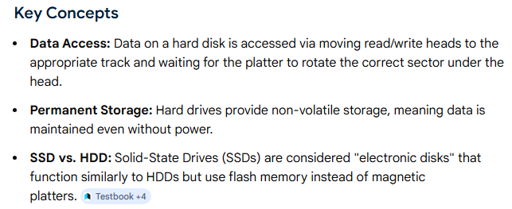

Slide 15
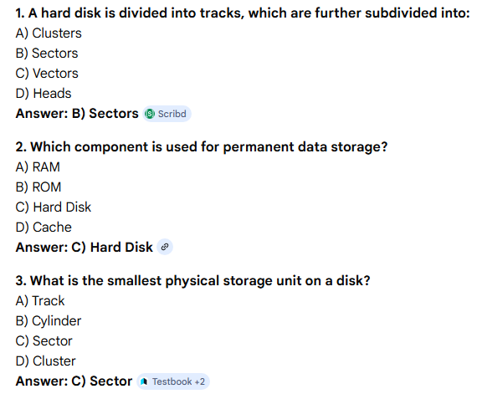

Slide 16
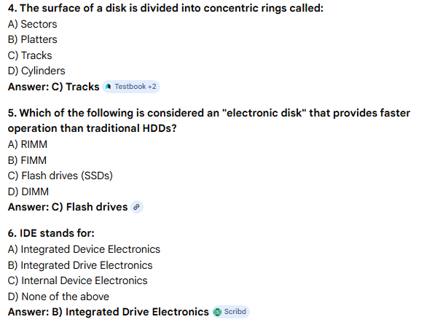

Slide 17
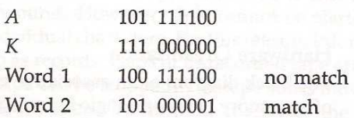
Associative Memory
- Accessed by the content of the data rather than by an address allowing for fast, parallel searches
- Also called Content Addressable Memory (CAM)
Hardware Organization
Argument register(A)
Key register (K)
Match
register
Input
Associative memory
array and logic
M
Read
m words
Write
n bits per word

Slide 18
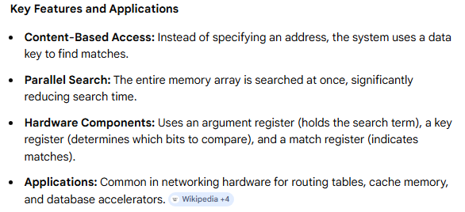

Slide 19
Organization of CAM
A₁
A_{j}
A_{n}
K₁
K_{j}
K_{n}
i= word
j-= bit in word
Word 1
C₁₁
C_{1j}
C_{1n}
M₁
Word i
C_{i1}
C_{ij}
C_{in}
M_{i}
Word m
C_{m1}
C_{mj}
C_{mn}
M_{m}
Bit 1
Bit j
Bit n
Internal organization of a typical cell C_{ij}
Input
A_{j}
K_{j}
Write
R
S
F
Match
To
M
Read
ij
logic
i
Output

Slide 20
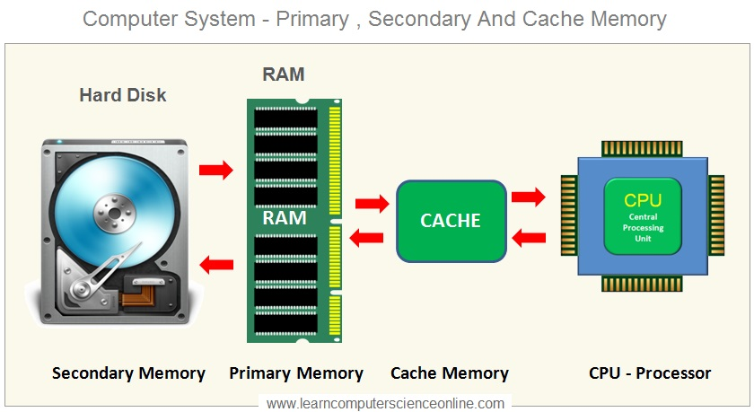

Slide 21
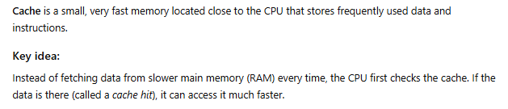

Slide 22
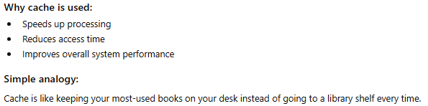
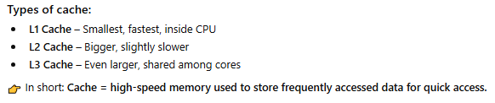

Slide 23
Cache Memory
Locality of Reference
- The references to memory at any given time interval tend to be confined within a localized areas.
- This area contains a set of information and the membership changes gradually as time goes by.
- Temporal Locality
The information which will be used in near future is likely to be in use already
( e.g. Reuse of same address or information in loops)
- Spatial Locality
If a word is accessed, adjacent(near) words are likely accessed soon
(e.g. Related or nearby data items (arrays) are usually stored together; instructions are executed sequentially)

Slide 24
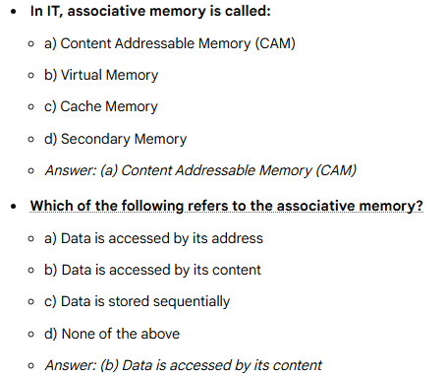

Slide 25
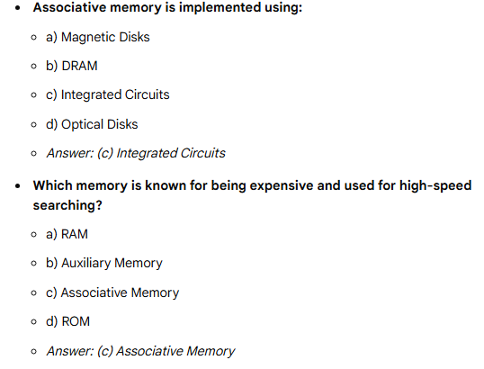

Slide 26
Cache Memory
Cache
- The property of Locality of Reference makes the cache memory systems work
- Cache is a fast small capacity memory that should hold those information
which are most likely to be accessed
Main memory
CPU
Cache memory

Slide 27
Performance of Cache
Memory Access
All the memory accesses are directed first to Cache
If the word is in Cache; Access cache to provide it to CPU
If the word is not in Cache; Bring a block (or a line) including that word to replace a block now in Cache
- How can we know if the word that is required is there ?
- If a new block is to replace one of the old blocks, which one should we choose ?

Slide 28
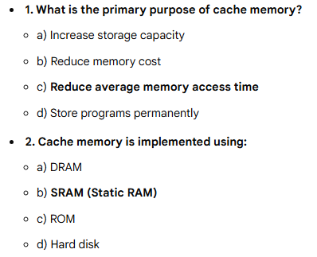

Slide 29
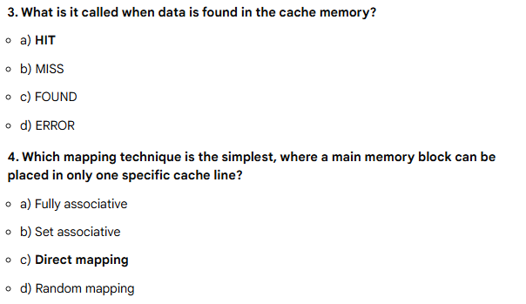


Slide 30
Performance of Cache
Performance of Cache Memory System
Hit Ratio - % of memory accesses satisfied by Cache memory system
Te: Effective memory access time in Cache memory system
Tc: Cache access time
Tm: Main memory access time
Te = Tc + (1 - h) Tm
Example: Tc = 0.4 ns, Tm = 1.2ns, h = 0.85%
Te = 0.4 + (1 - 0.85) * 1.2 = 0.58ns

Slide 31
Associative mapping
Associative mapping is a cache memory mapping technique
Any memory block can be placed in any cache line
No fixed location for storing data in cache
Uses tag comparison to identify data
All cache tags are compared simultaneously (parallel search)
Each cache line contains data + tag
If tag matches → cache hit
If no match → cache miss
Reduces conflict misses compared to direct mapping
Provides high flexibility and better cache utilization
Requires complex hardware (multiple comparators)
Higher cost and power consumption
Faster data access due to parallel searching
Commonly used in high-performance systems

Slide 32
Memory and Cache Mapping –
(Associative Mapping)
Mapping Function
Specification of correspondence between main memory blocks and cache blocks
They are of three types:
Associative mapping
Direct mapping
Set-associative mapping

Slide 33
Memory and Cache Mapping –
(Associative Mapping)
Associative Mapping
- Any block location in Cache can store any block in memory
-> Most flexible
- Mapping Table is implemented in an associative memory
-> Fast, very Expensive
- Mapping Table
Stores both address and the content of the memory word
address (15 bits)
Argument register
Address
Data
CAM
0 1 0 0 0
3 4 5 0
0 2 7 7 7
6 7 1 0
2 2 2 3 5
1 2 3 4

Slide 34
Cache Mapping – Direct mapping
- Each memory block has only one place to load in Cache
- Mapping Table is made of RAM instead of CAM
- n-bit memory address consists of 2 parts; k bits of Index field and n-k bits of Tag field
- n-bit addresses are used to access main memory and k-bit Index is used to access the Cache
n -k
k
Addressing Relationships
Tag(6) Index(9)
00 000
32K x 12
000
Main memory
512 x 12
Cache memory
Address = 15 bits
Address = 9 bits
Data = 12 bits
777
Data = 12 bits
77 777
Direct Mapping Cache Organization
Memory
Memory data
address
Cache memory
00000
1 2 2 0
Index
address
Tag
Data
00777
2 3 4 0
000
0 0
1 2 2 0
01000
3 4 5 0
01777
4 5 6 0
02000
5 6 7 0
02777
6 7 1 0
777
0 2
6 7 1 0

Slide 35
n -k
k
Addressing Relationships
Tag(6) Index(9)
00 000
32K x 12
000
512 x 12
Main memory
Cache memory
Address = 15 bits
Address = 9 bits
Data = 12 bits
Data = 12 bits
77 777
777
Direct Mapping Cache Organization
Memory
address
Memory data
00000
1 2 2 0
Cache memory
Index
address
Tag
Data
00777
2 3 4 0
000
0 0
1 2 2 0
01000
3 4 5 0
01777
4 5 6 0
02000
5 6 7 0
02777
777
0 2
6 7 1 0
6 7 1 0

Slide 36
Cache Mapping – Direct mapping
Operation
- CPU generates a memory request with (TAG;INDEX)
- Access Cache using INDEX ; (tag; data)
Compare TAG and tag
- If matches -> Hit
Provide Cache(data) to CPU
- If not match -> Miss
Search main memory and replace the block from cache memory
Direct Mapping with block size of 8 words
Block 0
000
0 1
3 4 5 0
Tag Block Word
007
0 1
6 5 7 8
010
INDEX
Block 1
017
Block 63
770
0 2
777
0 2
6 7 1 0

Slide 37
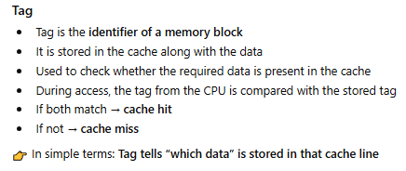
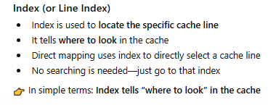

Slide 38
Direct mapping is a cache memory mapping technique
Each memory block maps to only one specific cache line
Cache is divided into fixed lines, and memory blocks are assigned uniquely
Address is divided into Tag + Line Index + Offset
Only one location is checked for a given memory block
If tag matches → cache hit
If not → cache miss and data is replaced
Simple and easy to implement
Requires less hardware (no parallel comparison)
Faster access time due to simple lookup
Suffers from conflict misses (multiple blocks compete for same line)
Lower cache utilization compared to associative mapping
Cost-effective and widely used in basic systems

Slide 39
Cache Mapping –
Set Associative Mapping
- Each memory block has a set of locations in the Cache to load
Set Associative Mapping Cache with set size of two
Index
Tag
Data
Tag
Data
000
0 1
3 4 5 0
0 2
5 6 7 0
777
0 2
6 7 1 0
0 0
2 3 4 0

Slide 40
Writing into Cache Concepts
Cache Write : Write Through and write Back
Write Through
When writing into memory
If Hit, both Cache and memory is written in parallel
If Miss, Memory is written
For a read miss, missing block may be overloaded onto a cache block
Memory is always updated
-> Important when CPU and DMA I/O are both executing
Slow, due to the memory access time

Slide 41
Cache Write
Write-Back (Copy-Back)
When writing into memory
If Hit, only Cache is written
If Miss, missing block is brought to Cache and write into Cache
For a read miss, candidate block must be written back to the memory
Memory is not up-to-date, i.e.,
The same item in Cache and memory may have different value

Slide 42
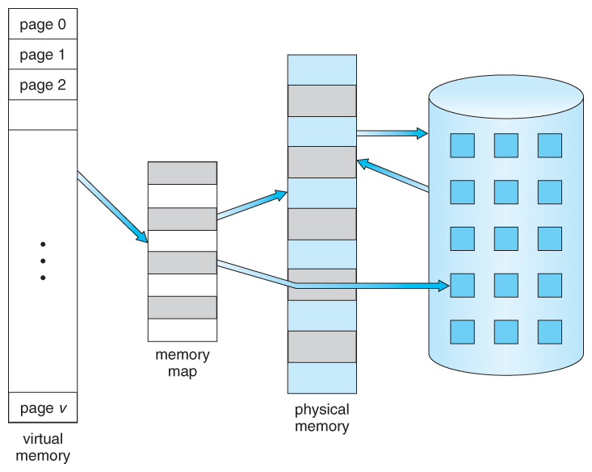
VIRTUAL MEMORY

Slide 43
Virtual Memory
Give the programmer the illusion that the system has a very large memory, even though the computer actually has a relatively small main memory
Address Space(Logical) and Memory Space(Physical)
address space
memory space
virtual address
(logical address)
Mapping
physical address
address generated by programs actual main memory address
Address Mapping
Memory Mapping Table for Virtual Address -> Physical Address
Virtual address
Virtual
Memory
Main memory
address
mapping
address
Main
register
table
register
memory
Physical
Address
Memory table
Main memory
buffer register
buffer register

Slide 44
Address Mapping
Address Space and Memory Space are each divided into fixed size group of words called blocks or pages
1K words group
Page 0
Page 1
Address space
N = 8K = 2¹³
Page 2
Block 0
Page 3
Memory space
M = 4K = 2¹²
Block 1
Page 4
Block 2
Page 5
Block 3
Page 6
Page 7
Organization of memory Mapping Table in a paged system (Page and line no.)
Page no.
Line number
1 0 1
0 1 0 1 0 1 0 0 1 1
Virtual address
Table
Presence
address
bit
000
0
Main memory
001
11
1
Block 0
010
00
1
Block 1
011
0
0 1
0 1 0 1 0 1 0 0 1 1
Block 2
100
0
Main memory
Block 3
101
01
1
address register
Memory page table
110
10
1
111
0
MBR
01
1

Slide 45
Associative Memory Page Table
Assume that
Number of Blocks in memory = m
Number of Pages in Virtual Address Space = n
Page Table
- Straight forward design -> n entry table in memory Inefficient storage space utilization
<- n-m entries of the table is empty
- More efficient method is m-entry Page Table
Page Table made of an Associative Memory
m words; (Page Number: Block Number)
Virtual address
Page no.
1 0 1
Line number
Argument register
1 0 1 0 0
Key register
0 0 1 1 1
0 1 0 0 0
Associative memory
1 0 1 0 1
1 1 0 1 0
Page no.
Block no.
Page Fault
Page number cannot be found in the Page Table

Slide 46
Page Replacement
Decision on which page to displace to make room for an incoming page when no free frame is available
valid/
frame
invalid bit
swap
out
1
victim
2
page
f
0
v
i
change to
victim
invalid
3
v
4
swap
f
reset page
desired
table for
page in
new page
backing store
page table
physical memory

Slide 47
Page Replacement
Modified page fault service routine
1. Find the location of the desired page on the backing store
2. Find a free frame
- If there is a free frame, use it
- Otherwise, use a page-replacement algorithm to select a victim frame
- Write the victim page to the backing store
3. Read the desired page into the (newly) free frame
4. Restart the user process
valid/
frame
invalid bit
swap
out
1
victim
2
page
f
0
v
i
change to
victim
invalid
3
v
4
swap
f
reset page
desired
table for
page in
new page
backing store
page table
physical memory

Slide 48
Page Replacement Algorithms
FIFO
Reference string
7
0
1
2
0
3
0
4
2
3
0
3
2
1
2
0
1
7
0
1
7
7
7
2
2
2
4
4
4
0
0
0
7
7
7
0
0
0
3
3
3
2
2
2
1
1
1
0
0
1
1
1
0
0
0
3
3
3
2
2
2
1
Page frames
FIFO algorithm selects the page that has been in memory the longest time.
Using a queue - every time a page is loaded, its identification is inserted in
the queue.
Easy to implement.
May result in a frequent page fault.
-
0
1
2
0
3
0
4
2
3
0
3
2
1
2
0
1
7
0
1
7
7
7
2
2
2
2
2
7
0
0
0
0
4
0
0
0
1
1
3
3
3
1
1
Page frames

Slide 49
Page Replacement Algorithms
LRU
- LRU uses the recent past as an approximation of near future.
Replace that page which has not been
used for the longest period of time
Reference string
7
0
1
2
0
3
0
4
2
3
0
3
2
1
2
0
1
7
0
1
7
7
7
2
2
4
4
4
0
1
1
1
0
0
0
0
0
0
3
3
3
0
0
1
1
3
3
2
2
2
2
2
7
Page frames
LRU may require substantial hardware assistance.
The problem is to determine an order for the frames defined by the time of last use.

Slide 50
Parallel Computers
Architectural Classification
Flynn's classification
Based on the multiplicity of Instruction Streams and Data Streams
Instruction Stream
Sequence of instructions read from memory
Data Stream
Operations performed on the data in the processor
 |  | Number of Data Streams
 |  | Single | Multiple
Number of Instruction Streams | Single | SISD | SIMD
 | Multiple | MISD | MIMD

Slide 51
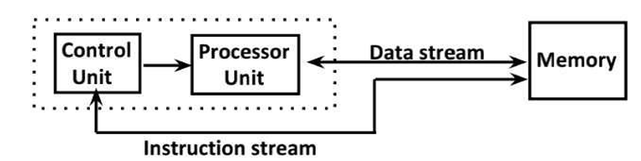
SISD
Characteristics
Single computer containing a control unit, processor and memory unit
- Instructions and data are stored in memory and executed sequentially
may or may not have parallel processing
- parallel processing can be achieved by pipelining

Slide 52
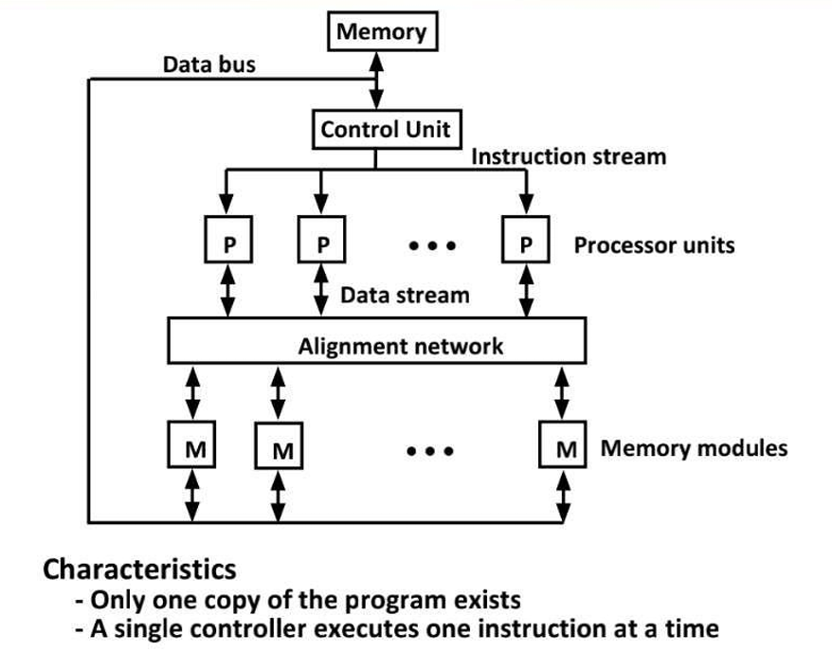
SIMD

Slide 53
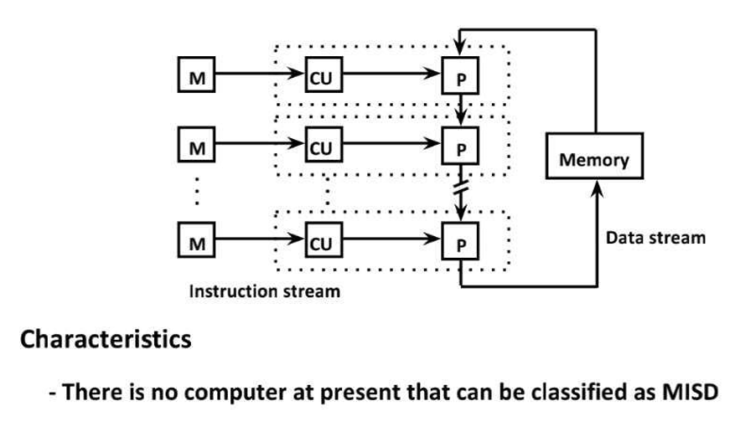
MISD

Slide 54
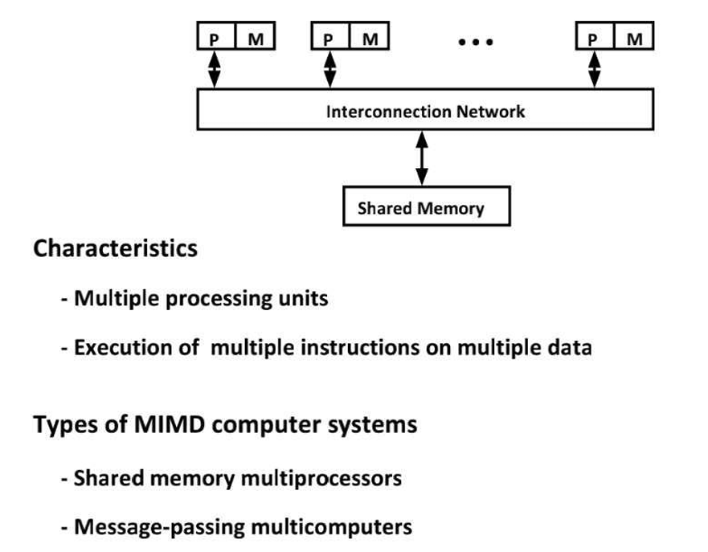
MIMD

Slide 55
Pipelining
A technique of decomposing a sequential process into sub operations, with each sub process being executed in a special dedicated segment that operates concurrently with all other segments.
It is the characteristic of pipelining that several computations can be in progress in distinct segments at the same time.
Each segment performs partial processing dictated by the way the task is dictated
The result obtained from computation is in each segment is transferred to next segment in the pipeline
The final result is obtained after data has been passed through all segment

Slide 56
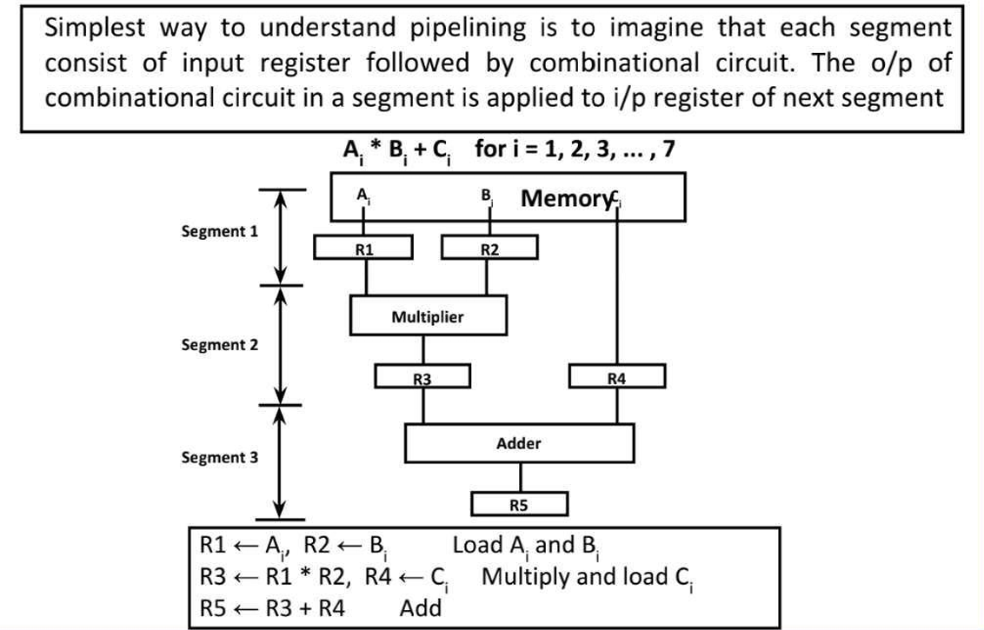
Pipelining

Slide 57
Design of a basic pipeline
•In a pipelined processor, a pipeline has two ends, the input end
and the output end. Between these ends, there are multiple stages/segments such that output of one stage is connected to input of next stage and each stage performs a specific operation.
•Interface registers are used to hold the intermediate output between two stages. These interface registers are also called latch or buffer.
•AII the stages in the pipeline along with the interface registers are
controlled by a common clock.

Slide 58
Pipeline Stages
RISC processor has 5 stage instruction pipeline to execute ali the instructions in the RISC instruction
set. Following are the 5 stages of RISC pipeline with their respective operations:
Stage 1 (Instruction Fetch)
In this stage the CPU reads instructions from the address in the memory whose value is present in the
program counter.
Stage 2 (Instruction Decode)
In this stage, instruction is decoded and the register file is accessed to get the values from the registers used in the instruction.

Slide 59
Pipeline Stages
Stage 3 (Instruction Execute)
In this stage, ALU operations are performed.
Stage 4 (Memory Access)
In this stage, memory operands are read and written from/to the memory that is present in the
instruction.
Stage S (Write Back)
In this stage, computed/fetched value is written back to the register present in the instruction.

Slide 60
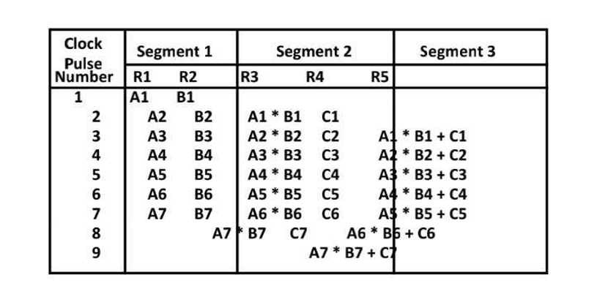
Operations in each Pipeline Stage

Slide 61
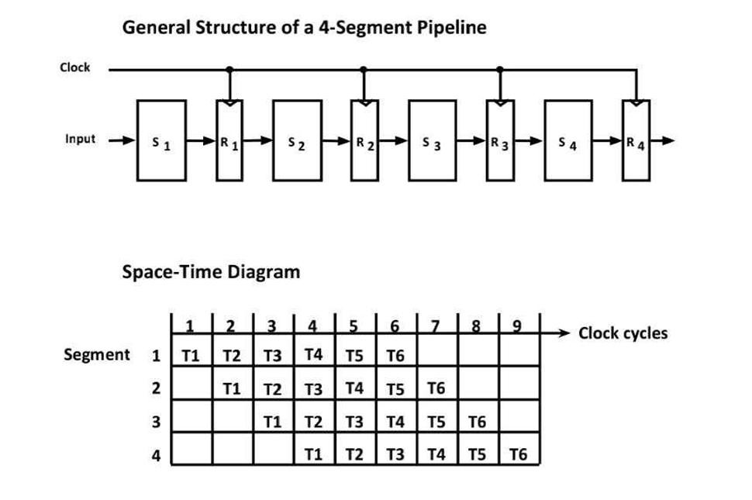
General Pipelining

Slide 62
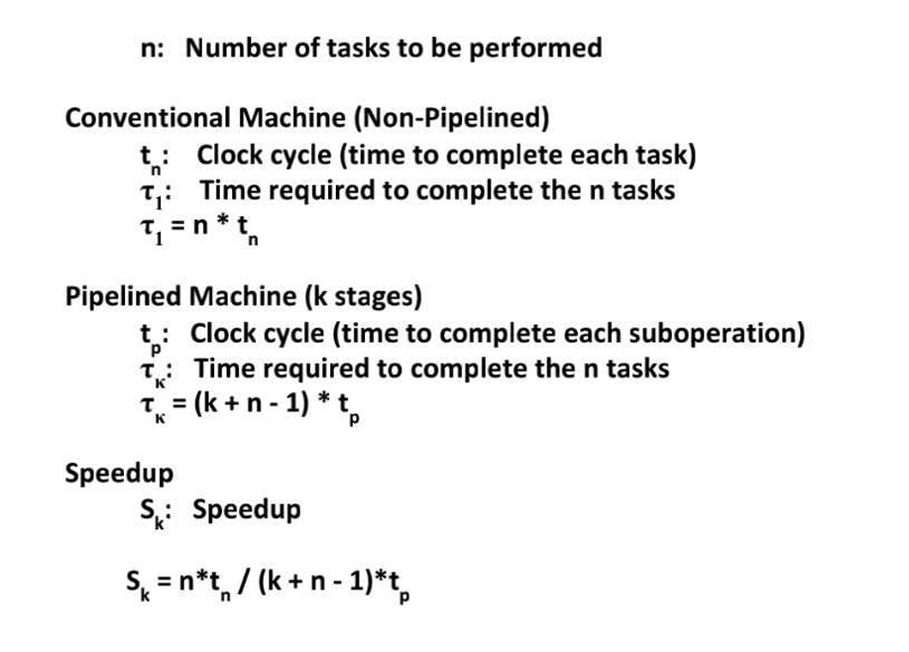
Pipelining speed up

Slide 63
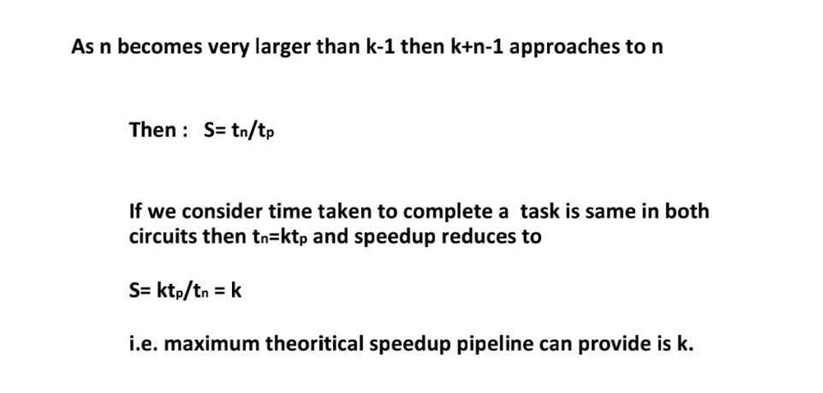
Pipelining speed up

Slide 64
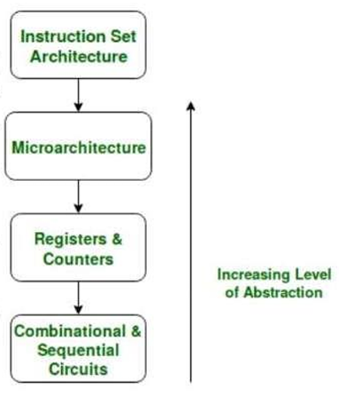
Pipeline Stages
An ISA describes the design of a Computer in terms of the basic operations it must support. The ISA is not concerned with the implementation specific details of a computer. It is only concerned with the set or collection of basic operations the computer must support.
For example the AMD Athlon and the Core 2 Duo processors have entirely different implementations but they support more or less the
same set of basic operations as defined in the x86 Instruction Set.
Micro architectural level lies just below the ISA level and hence is concerned with the implementation of the basic operations to be supported by the Computer as defined by the ISA. Therefore we can say that the AMD Athlon and Core 2 Duo processors are based on the same ISA but have different microarchitectures with different performance and efficiencies.

Slide 65
Multiprocessors
A shared-memory multiprocessor (or just multiprocessor henceforth) is a computer system in which two or more CPUs share full access to a common RAM.
A program running on any of the CPUs sees a normal (usually paged) virtual address space.

Slide 66
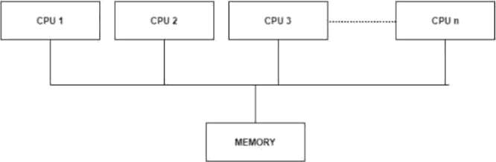
The only unusual property this system has is that the CPU can write some value into a memory word and then read the word back and get a different value (because another CPU has changed it).

Slide 67
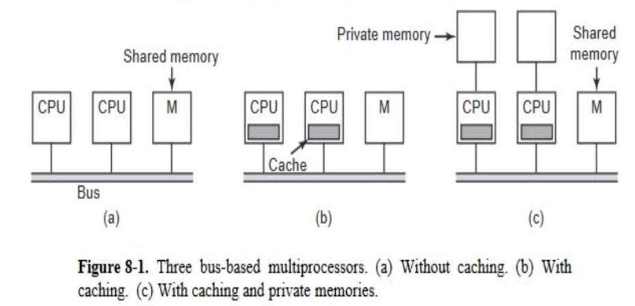
Multiprocessor architectures
Two or more CPUs and one or more memory modules all use the same bus for communication. When a CPU wants to read a memory word, it first checks to see if the bus is busy. If the bus is idle, the CPU puts the address of the word it wants on the bus, asserts a few control signals, and waits until the memory puts the desired word on the bus.

Slide 68
ProbIem to previous approach, If the bus is busy when a CPU wants to read or write memory, the CPU just waits until the bus becomes idle.
The cache can be inside the CPU chip, next to the CPU chip, on the processor board, or some combination of all three.
Since many reads can now be satisfied out of the local cache, there will be much less bus traffic, and the system can support more CPUs.
(c) in this each CPU has not only a cache, but also a local, private memory which it accesses over a dedicated (private) bus.
To use this configuration optimally, the compiler should place all the program text, strings, constants and other read-only data, stacks, and local variables in the private memories.
The shared memory is then only used for writable shared variables.

Slide 69
Types of Multiprocessors
There are mainly two types of multiprocessors i.e. symmetric and asymmetric
multiprocessors. Details about them are as follows:
• Symmetric Multiprocessors
ln these types of systems, each processor contains a similar copy of the operating system and they all communicate with each other. All the processors are in a peer to peer relationship i.e. no master - slave relationship exists between them.
An example of the symmetric multiprocessing system is the Encore version of Unix for the Multimax Computer.

Slide 70
Types of Multiprocessors
• Asymmetric Multiprocessors
ln asymmetric systems, each processor is given a predefined task. There is a master processor that gives instruction to all the other processors. Asymmetric multiprocessor system contains a master slave relationship.
Asymmetric multiprocessor was the only type of multiprocessor available before symmetric multiprocessors were created. Now also, this is the cheaper option.

Slide 71
Advantages of Multiprocessor Systems
There are multiple advantages to multiprocessor systems. Some of these are:
More reliable Systems In a multiprocessor system, even if one processor fails, the system will not halt. For example: If there are 5 processors in a multiprocessor system and one of them fails, then also 4 processors are still working. So the system only becomes slower and does not ground to a halt.
Enhanced Throughput If multiple processors are wDrking in tandem, then the throughput of the system increases i.e. number of processes getting executed per unit of time increase. If there are N processors then the throughput increases by an amount just under N.
More Economic Systems Multiprocessor systems are cheaper than single processor systems in the long run because they share the data storage, peripheral devices, power supplies etc. If there are multiple processes that share data, it is better to schedule them on multiprocessor systems with shared data than have different computer systems with muItipIe copies of the data.

Slide 72
Disadvantages of Multiprocessor Systems
There are some disadvantages as well to multiprocessor systems. Some of
these are:
lncreased Expense Even though multiprocessor systems are cheaper in the long run than using multiple computer systems, still they are quite expensive. It is much cheaper to buy a simple single processor system than a multiprocessor system.
Complicated Operating System Required There are multiple processors in a multiprocessor system that share peripherals, memory etc. So, it is much more complicated to schedule processes and impart resources to processes, than in single processor systems. Hence, a more complex and complicated operating system is required in multiprocessor systems.
Large Main Memory Required All the processors in the multiprocessor system share the memory. So a much larger pool of memory is required as compared to single processor systems.

Slide 73
Coupling of Processors
Tightly Coupled System
Tasks and/or processors communicate in a highly synchronized fashion
Communicates through a common shared memory
Shared memory system
Loosely Coupled System
Tasks cir processors do not communicate in a synchronized fashion
Communicates by message passing packets
Overhead for data exchange is high
Distributed memory system

Slide 74
Interconnection Structure
The components that form a multiprocessor system are CPUs, IOPs connected to input-output devices, and a memory unit.
The interconnection between the components can have different physical configurations, depending on the number of transfer paths that are available.
Between the processors and memory in a shared memory system
Among the processing elements in a loosely coupled system
There are several physical forms available for establishing an interconnection network.
1. Time-shared common bus
2. Multiport memory
3. Crossbar switch

Slide 75






Time Shared Common Bus
A common-bus multiprocessor system consists of a number of processors
connected through a common path to a memory unit.
Only one processor can communicate with the memory or another processor at any given time.
As a consequence, the total overall transfer rate within the system is limited by the speed of the single path.
A more economical implementation of a dual bus structure is depicted in Fig. below.
Part of the local memory may be designed as a cache memory attached to the CPU.

Slide 76
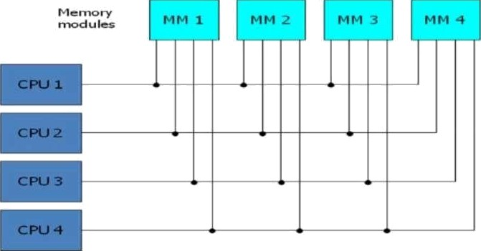
MuItiport Memory
A multiport memory system employs separate buses between each memory module
and each CPU.
The module must have internal control logic to determine which port will have access to memory at any given time, Memory access conflicts are resolved by assigning fixed priorities to each memory port.
Adv..
The high transfer rate can be achieved because of the multiple paths.
Disadv.:
It requires expensive memory control logic and a large number of cables and
connections

Slide 77
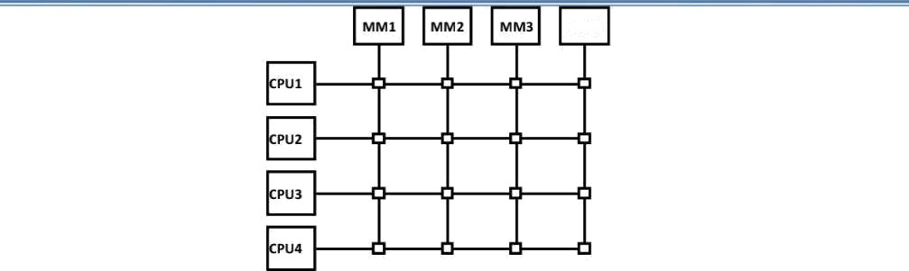
Cross Bar Switch
Consists of a number of crosspoints that ore placed ot intersections between processor buses and memory module paths.
The small square in each crosspoint is a switch thot determines the path /rom a processor to o memory module.
Adv.:
Supports simultaneous transfers from all memory modules
Disadv.:
The hardware required to implement the switch can become quite large and complex.
fig. shows the functional design of a crossbar switch connected to one memory module.

